Slide 1
Sentiment Analysis on Mass Deportation of Illegal Immigrants
Understanding Public Opinion through Text Mining
BY: Group 2
Rithvik Dhanpal
Saketh Ram Josyabhatla
Shivani Pakala
Swetha Kambham
Venkata Rama Chandra mouli Gabbiti

Slide 2
Introduction:
Objective:
To perform sentiment analysis on Reddit comments related to mass deportation.
Understand public opinion: Positive, Neutral, or Negative.
Dataset Overview:
Sourced from Reddit
Dataset has different columns like comments, Karma scores and awards.
Key Questions:
What are the dominant sentiments?
How do karma and awards vary by sentiment?

Slide 3
Dataset Description
Dataset is scraped from the reddit public comments
Dataset contains 7 columns and 9400 rows in total
In the process of data cleaning we have added one more column to it.
Key columns used are:
raw_comment: User comments for sentiment analysis.
karma: This reflects user engagement on Reddit, calculated as the difference between upvotes and downvotes on a comment or post.
awards: Number of awards given to the comment.
Datatype Summary:
raw_comment column is in text format where karma and awards columns are in numerical value format

Slide 4
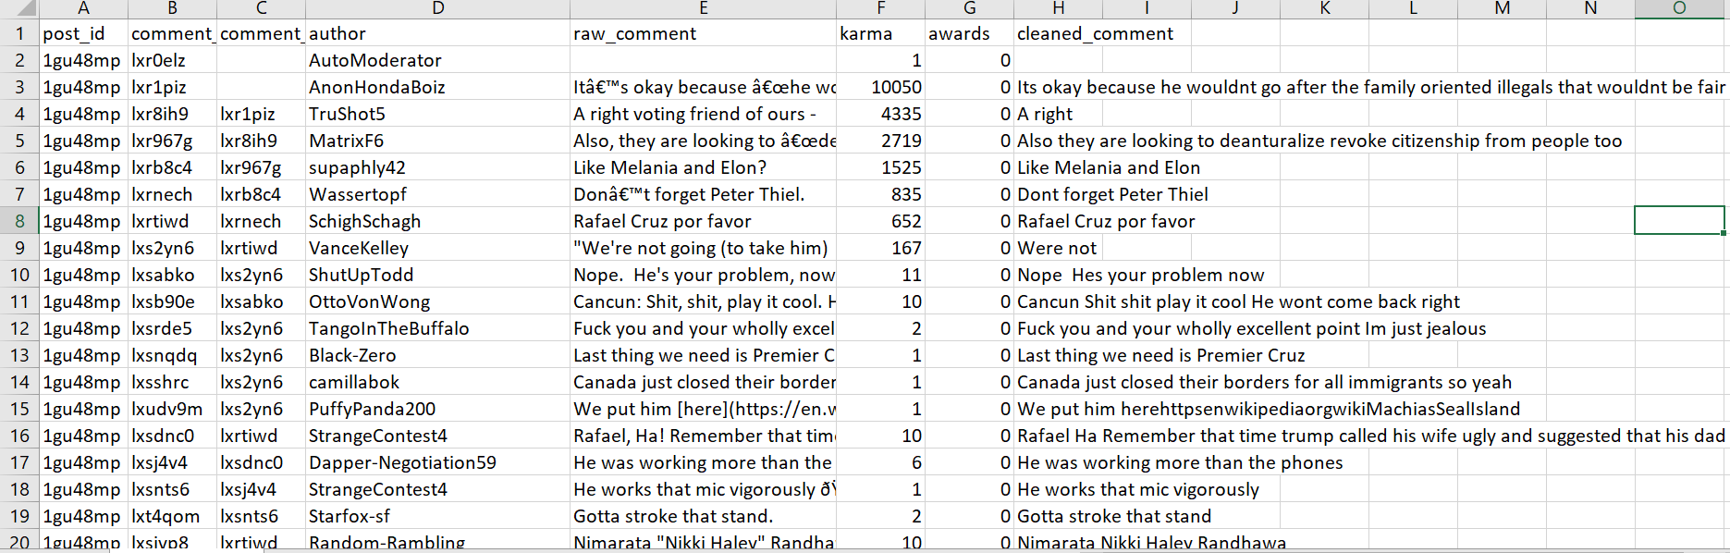
Dataset Snippet

Slide 5
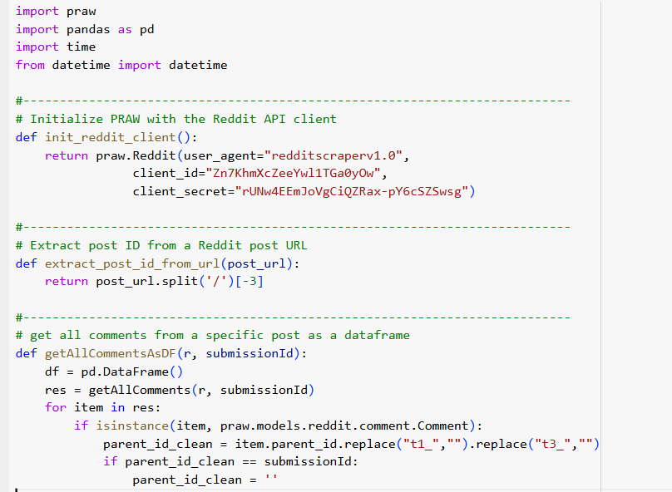
Scraping the Data
Libraries Used: PRAW(Python Reddit API Wrapper), Pandas and DateTime
Scraping Steps:
Initialize API: Set up Reddit client with credentials.
Extract Post ID: Parsed the Reddit post URL to extract its unique identifier.
Fetch Comments: Used recursive logic to retrieve comments and attributes like ID, text, karma, and awards
Handle Rate Limits: Incorporated retry logic to manage Reddit’s API rate limits.
Save Data: Export comments to a CSV file.

Slide 6
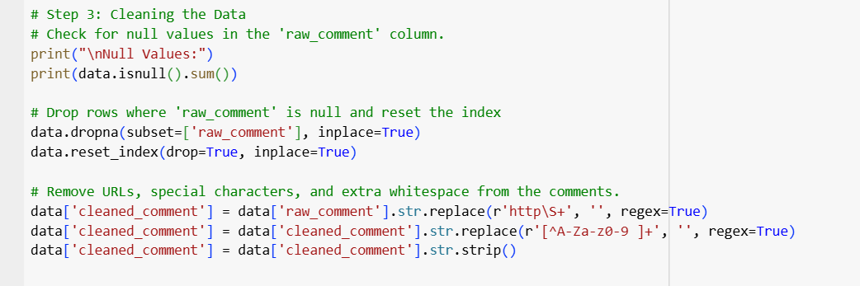
Data Cleaning
Cleaning Steps:
Removed rows with null values in raw_comment.
Eliminated URLs, special characters, and extra spaces from comments.
Created a new column cleaned_comment for preprocessed text.
Tools Used:
Python libraries: pandas, regex.

Slide 7
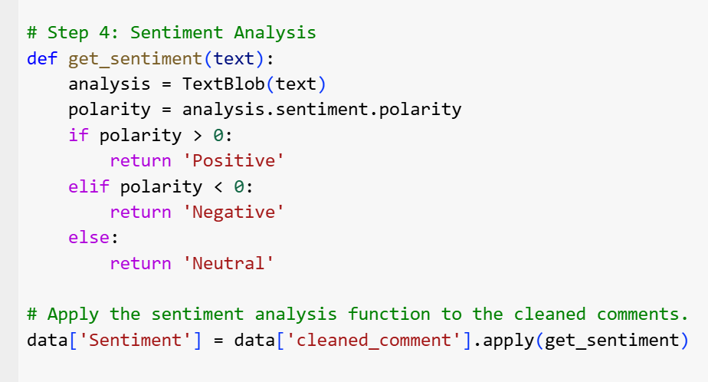
Methodology
Steps in Sentiment Analysis:
Data Cleaning and Preprocessing.
Sentiment Classification using TextBlob.
The classification is done in 3 steps
Positive: Polarity > 0
Neutral: Polarity = 0
Negative: Polarity < 0
Tools Used:
Python libraries: pandas, TextBlob, matplotlib, seaborn.

Slide 8
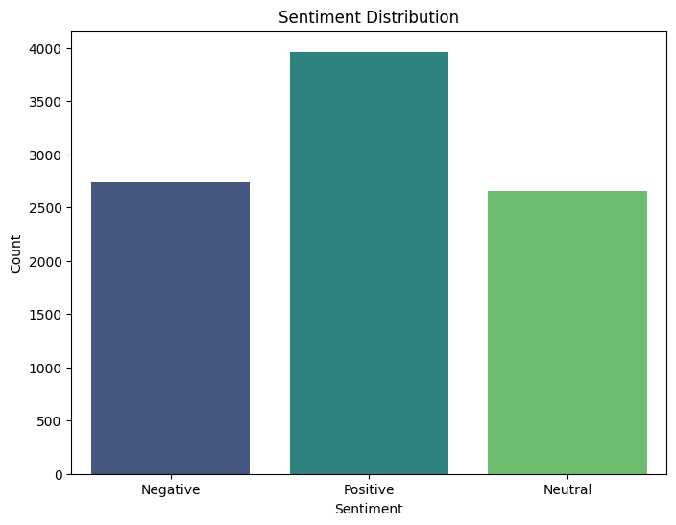
Visualization 1: Sentiment Distribution
Bar graph illustrating the counts of Positive, Neutral, and Negative sentiments.
Objective: To analyze the overall sentiment distribution in the dataset.
Observation:
Highlight the dominant sentiment category.
Evaluate the balance or skewness among sentiment categories.

Slide 9
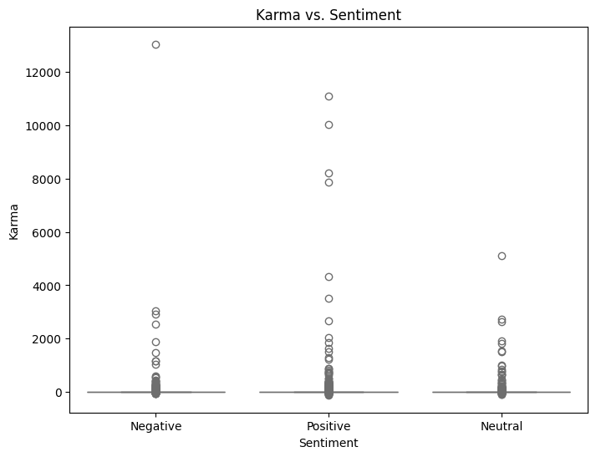
Visualization 2: Karma Vs Sentiment
Visualization: Boxplot illustrating the distribution of karma scores across Positive, Neutral, and Negative sentiment categories.
Objective: Analyze whether there is a correlation between sentiment type and karma scores.
Observation: Identify trends such as higher or lower karma scores associated with specific sentiments.
Use:
Understand Sentiment Impact: Helps determine if sentiment influences the engagement level (measured by karma scores) of Reddit comments.
Insight into Public Reaction: Identifies whether positive, neutral, or negative sentiments are more likely to receive higher karma scores, reflecting user agreement or approval.

Slide 10
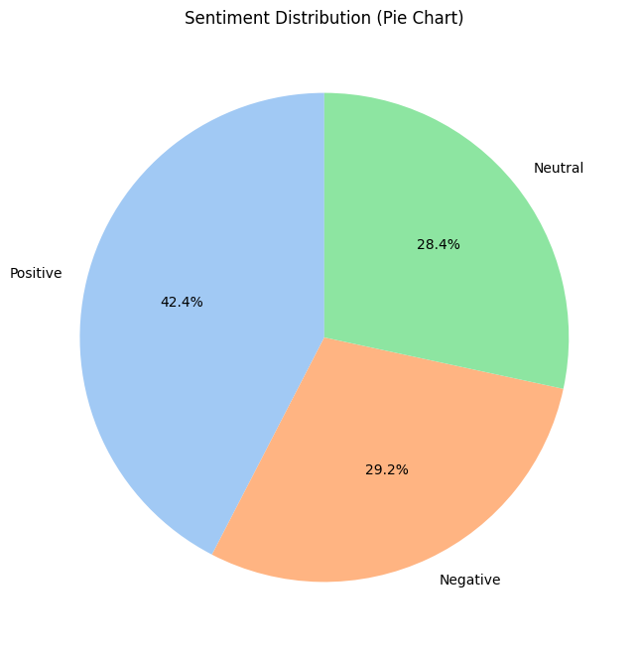
Visualization 3: Sentiment Distribution
Visualization: Pie chart depicting the sentiment distribution across the dataset: Positive, Neutral, and Negative sentiments.
Objective: Provide an overview of the proportion of comments classified into different sentiment categories.
Observation: The chart shows that 42.4% of the comments are positive, 29.2% are negative, and 28.4% are neutral, highlighting the dominant sentiment as positive.
Use:
Understand Public Opinion: The pie chart gives a clear insight into how Reddit users feel about the topic of mass deportation, offering a quick overview of public sentiment.

Slide 11
Results and Observations
Sentiment Distribution: 42.4% positive, 29.2% negative, and 28.4% neutral comments, showing varied public opinion.
Karma Scores: Positive comments tend to receive higher karma, indicating greater user engagement.
Awards: Positive comments receive more awards, reflecting higher recognition.
Negative Sentiment: A significant portion of comments (29.2%) express negative sentiment, highlighting public concern.
Controversy: Negative comments show varied karma scores, indicating divisive opinions.
Public Validation: Positive sentiment attracts more recognition, while negative sentiment receives less.

Slide 12
Conclusion
Majority sentiment was positive, with significant sentiment distribution observed.
A correlation exists between sentiment polarity and engagement (karma and awards).
Positive comments received higher karma and more awards.
Advanced NLP models like BERT could improve sentiment analysis accuracy.
Expanding analysis to other platforms could provide broader insights.
Further research can refine sentiment understanding in socio-political discussions.

Slide 13
THANK YOU

